Slide 1
FINA 1303 FOUNDATIONS OF INTEREST RATES Part II
Veronique Lafon-Vinais
Associate Professor of Business Education - Department of Finance

Slide 2
Course Map
Overview
Foundations of
Interest Rates
Financial Institutions
Pricing of Financial Assets
Regulations
DCF
Sell Side
Buy Side
Stock
Valuation
Banking Regulation
Basics of
Interest Rates
Commercial Banking
Traditional Institutional Investors
Asset
Pricing
Models
Monetary Policy
Investment Banking
Alternative Investors
2

Slide 3
Overview
Foundations of
Interest Rates
Students will establish an understanding of
Bond Pricing Basics
Zero Coupon Bond
Coupon Bond
Computing interest for short term debt
DCF
Basics of
Interest Rates

Slide 4
Bond Basics
A bond is a financial instrument promising to make a series of payments on specific dates. It is similar to a loan but unlike loans, bonds are securities (negotiable, transferable financial instruments)
Bonds are legal contracts between an issuer and the investors (buyers) that:
Require the issuer to make payments to the buyer, and
Specify in great detail all the terms and conditions, including what happens in case the issuer fails to make a payment (called “event of default”)

Slide 5
Bond Basics: Coupon Bond
The most common type of bond is a coupon bond:
Issuer is required to make regular payments, called coupon payments.
The interest the issuer pays, and which is used to calculate the coupons, is the coupon rate.
The frequency of the coupon payments is annual or semi-annual (USA).
The date on which the principal of the bond is repaid is the maturity date.
The final payment includes (1) the principal, face value, or par value of the bond and (2) the final coupon payment.

Slide 6
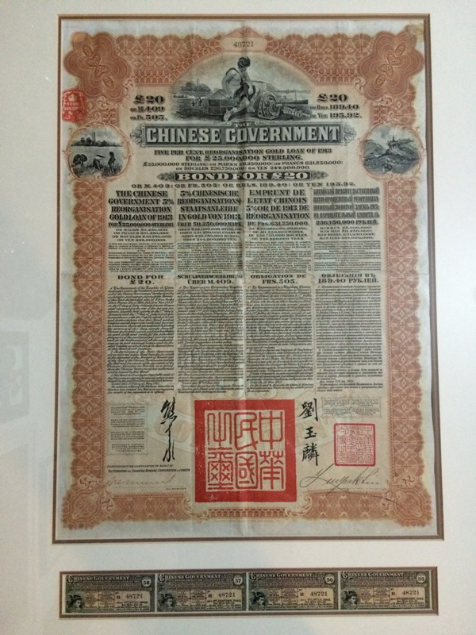
Coupon Bond
Script coupon bond as buyer would receive a certificate with coupons attached.
Coupons not yet paid

Slide 7
Key Formulas: Bond Price
That formula for fixed cash flows with a residual value on maturity date is also the general formula that covers many different cases of DCF calculations but is also the way (for you for now) to value bonds based on Coupon (C), Principal (P), Number of Years (n), Yield To Maturity (i):

Slide 8
Key Formulas: Bond Price
If P=0 that is our mortgage case (in part I),
If P=0 and n=∝ AND i > 0, then it is a consol or a perpetual bond:
If C= 0 it is a Zero-Coupon Bond:

Slide 9
Zero Coupon Bonds

Slide 10
Zero-Coupon Bonds
Zero-coupon bonds
Only two cash flows
The bond’s market price at the time of purchase
The bond’s face value (principal P) at maturity
Copyright ©2015 Pearson Education, Inc. All rights reserved.
Notes:
10

Slide 11
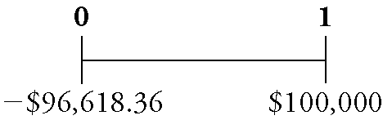
Zero-Coupon Bonds - Example
A one-year zero-coupon bond with a $100,000 face value has an initial price of $96,618.36
If you purchased this bond and held it to maturity, you would have the following cash flows:
Copyright ©2015 Pearson Education, Inc. All rights reserved.
Notes:
11

Slide 12
Zero-Coupon Bonds
Yield to Maturity of a Zero-Coupon Bond
The discount rate that sets the present value of the promised bond payments equal to the current market price of the bond
This is the same problem as when we solved for the rate of return
Yield to Maturity of an n-Year Zero-Coupon Bond:
Copyright ©2015 Pearson Education, Inc. All rights reserved.
Notes:
12

Slide 13
Example: Yields for Different Maturities
Suppose the following zero-coupon bonds are trading at the prices shown below per $100 face value.
Determine the corresponding yield to maturity (YTM) for each bond.
Maturity | 1 year | 2 years | 3 years | 4 years
Price | $96.62 | $92.45 | $87.63 | $83.06
Copyright ©2015 Pearson Education, Inc. All rights reserved.
Notes:
13

Slide 14
Example: Yields for Different Maturities
We can use our equation to solve for the YTM of the bonds.
The table gives the prices and number of years to maturity.
Copyright ©2015 Pearson Education, Inc. All rights reserved.
Notes:
14

Slide 15
Example: Yields for Different Maturities
We have
Copyright ©2015 Pearson Education, Inc. All rights reserved.
Notes:
15

Slide 16
Example: Yields for Different Maturities
Solving for the YTM of a zero-coupon bond is the same process we used to solve for the rate of return.
Indeed, the YTM is the rate of return of buying the bond.
NB: we can do it quickly in our calculator, where we solve for i, with n = tenor (number of periods) PMT is zero (no coupons), FV is $100 (par value) and PV is the price (with negative cash flow)
Copyright ©2015 Pearson Education, Inc. All rights reserved.
Notes:
16

Slide 17
Your Turn!
Suppose the following zero-coupon bonds are trading at the prices shown below per $100 face value.
Determine the corresponding yield to maturity for each bond.
Maturity | 1 year | 2 years | 3 years | 4 years
Price | $98.52 | $96.59 | $94.23 | $91.48
Copyright ©2015 Pearson Education, Inc. All rights reserved.
Notes:
17

Slide 18

Your Turn (PRS please)
The YTMs are
1 year bond:
1.2%
1.5%
1.7%
2 year bond:
1.6%
1.75%
1.8%
3 year bond:
1.9%
2.0%
2.5%
4 year bond:
2.0%
2.25%
3%

Slide 19
Solution: Yields for Different Maturities
We can solve for the YTM of the bonds. The table gives the prices and number of years to maturity.
NB: we can do it quickly in our calculator, where we solve for i, with n= tenor (number of periods) PMT is zero (no coupons), FV is $100 (par value) and PV is the price (with negative cash flow)
Copyright ©2015 Pearson Education, Inc. All rights reserved.
Notes:
19

Slide 20
Solution: Yields for Different Maturities
We have
Copyright ©2015 Pearson Education, Inc. All rights reserved.
Notes:
20

Slide 21
Solution: Yields for Different Maturities
Solving for the YTM of a zero-coupon bond is the same process we used to solve for the rate of return.
Indeed, the YTM is the rate of return of buying the bond.
Copyright ©2015 Pearson Education, Inc. All rights reserved.
Notes:
21

Slide 22
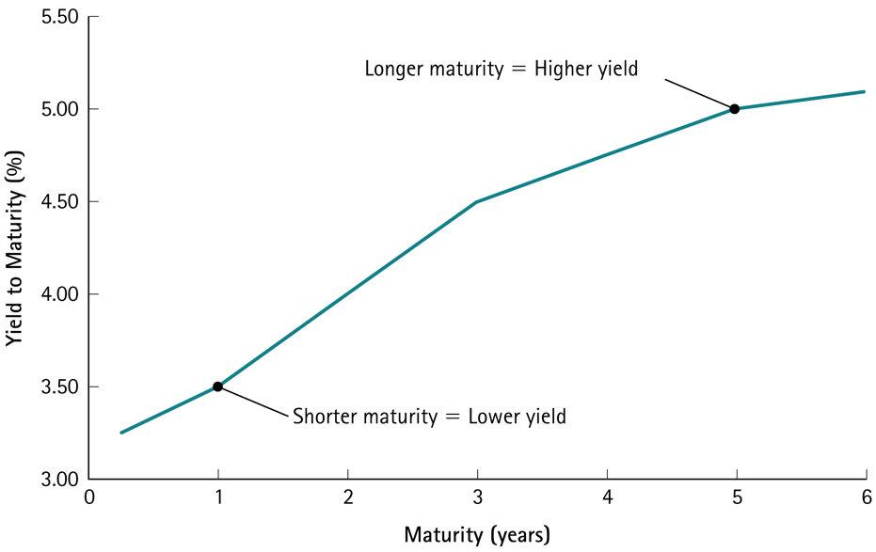
Example: Computing the Price of a Zero-Coupon Bond
Given the yield curve below, what is the price of a 5-year “risk-free” zero-coupon bond with a face value of $100?
Copyright ©2015 Pearson Education, Inc. All rights reserved.
Notes:
22

Slide 23
Example: Computing the Price of a Zero-Coupon Bond
We can use the bond’s yield to maturity to compute the bond’s price as the present value of its face amount, where the discount rate is the bond’s yield to maturity.
From the yield curve, the yield to maturity for 5-year “risk-free” zero-coupon bonds is 5.0%.
Copyright ©2015 Pearson Education, Inc. All rights reserved.
Notes:
23

Slide 24
Zero-Coupon Yield Curve Consistent with the Bond Prices in Example
Copyright ©2015 Pearson Education, Inc. All rights reserved.
Notes:
24

Slide 25
Example: Computing the Price of a Zero-Coupon Bond
Execute:
Copyright ©2015 Pearson Education, Inc. All rights reserved.
Notes:
25

Slide 26
Example: Computing the Price of a Zero-Coupon Bond
We can compute the price of a zero-coupon bond simply by computing the present value of the face amount using the bond’s yield to maturity.
Note that the price of the 5-year zero-coupon bond is even lower than the price of the other zero-coupon bonds in Example 6.1, because the face amount is the same but we must wait longer to receive it.
Copyright ©2015 Pearson Education, Inc. All rights reserved.
Notes:
26

Slide 27
Your Turn!
Given the yield curve below, what is the price of a 3-year risk-free zero-coupon bond with a face value of $900?
Copyright ©2015 Pearson Education, Inc. All rights reserved.
Notes:
27

Slide 28
Your Turn (PRS please)
The price is:
$900
$879
$788.67

Slide 29
Solution: Computing the Price of a Zero-Coupon Bond
We can use the bond’s yield to maturity to compute the bond’s price as the present value of its face amount, where the discount rate is the bond’s yield to maturity.
From the yield curve, the yield to maturity for 3-year risk-free zero-coupon bonds is 4.50%.
Copyright ©2015 Pearson Education, Inc. All rights reserved.
Notes:
29

Slide 30
Zero-Coupon Yield Curve Consistent with the Bond Prices in Example
Copyright ©2015 Pearson Education, Inc. All rights reserved.
Notes:
30

Slide 31
Solution: Computing the Price of a Zero-Coupon Bond
Execute:
P = 900 / (1.045)³ = $788.67
Copyright ©2015 Pearson Education, Inc. All rights reserved.
Notes:
31

Slide 32
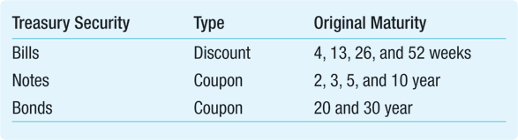
U.S. Government Securities “Treasuries”
Video on Tbills: https://www.youtube.com/watch?v=aVvDy9gVe90
https://www.treasury.gov/resource-center/data-chart-center/quarterly-refunding/Documents/auctions.pdf
The 30 year T-Bond is called the “long bond”
Because of their short tenor, US T-Bills are zero coupon. They trade at a discount to yield.
Copyright ©2015 Pearson Education, Inc. All rights reserved.
Notes:
32

Slide 33
Zero-Coupon Yield Curve
Copyright ©2015 Pearson Education, Inc. All rights reserved.
Notes:
33

Slide 34
Coupon Bonds

Slide 35
Coupon Bonds
Coupon bonds
Pay face value at maturity
Also make regular coupon interest payments
Return on a coupon bond comes from:
The difference between the purchase price and the principal value
Periodic coupon payments
To compute the yield to maturity of a coupon bond, we need to know the coupon interest payments, and when they are paid
Copyright ©2015 Pearson Education, Inc. All rights reserved.
Notes:
35

Slide 36
Key Formulas: Bond Price
That formula for fixed cash flows with a residual value on maturity date is also the general formula that covers many different cases of DCF calculations but is also the way (for you for now) to value bonds based on Coupon (C), Principal (P), Number of Years (n), Yield To Maturity (i):

Slide 37
Example: Computing the Yield to Maturity of a Coupon Bond
Consider a five-year, $1,000 bond with a 2.2% coupon rate and semiannual coupons .
If this bond is currently trading for a price of $963.11, what is the bond’s yield to maturity?
Copyright ©2015 Pearson Education, Inc. All rights reserved.
Notes:
37

Slide 38





Example: Computing the Yield to Maturity of a Coupon Bond
We can solve it by financial calculator, or a spreadsheet. To use a financial calculator, we enter the price we pay as a negative number for the PV (it is a cash outflow), the coupon payments as the PMT, and the bond’s par value as its FV. Finally, we enter the number of coupon payments remaining (10) as N.
Given: | 10 |  | -963.11 | 11 | 1,000
Solve for: |  | 1.50
Excel Formula: =RATE(NPER,PMT,PV,FV)= RATE(10,11,-963.11,1000)
Copyright ©2015 Pearson Education, Inc. All rights reserved.
Notes:
38

Slide 39
Example: Computing the Yield to Maturity of a Coupon Bond
Therefore, y = 1.50%.
Because the bond pays coupons semiannually, this yield is for a six-month period.
We convert it to an APR (annual percentage rate) by multiplying by the number of coupon payments per year.
Thus the bond has a yield to maturity equal to a 3.0% APR with semiannual compounding.
Copyright ©2015 Pearson Education, Inc. All rights reserved.
Notes:
39

Slide 40
Example: Computing the Yield to Maturity of a Coupon Bond
As the equation shows, the yield to maturity is the discount rate that equates the present value of the bond’s cash flows with its price.
Note that the YTM is higher than the coupon rate and the price is lower than the par value.
Copyright ©2015 Pearson Education, Inc. All rights reserved.
Notes:
40

Slide 41
Example: Computing a Bond Price from Its Yield to Maturity
Consider a five-year, $1,000 bond with a 2.2% coupon rate and semiannual coupons.
Suppose interest rates drop and the bond’s yield to maturity decreases to 2% (expressed as an APR with semiannual compounding).
What price is the bond trading for now?
Copyright ©2015 Pearson Education, Inc. All rights reserved.
Notes:
41

Slide 42
Example: Computing a Bond Price from Its Yield to Maturity
Given the yield, we can compute the price.
First, note that a 2.0% APR is equivalent to a semiannual rate of 1.0%.
Also, recall that the cash flows of this bond are 10 payments of $11, paid every 6 months, and one lump-sum cash flow of $1,000 (the face value), paid in 5 years (ten 6-month periods).
We can compute the effective annual yield from the bond’s yield to maturity expressed as an APR.
Copyright ©2015 Pearson Education, Inc. All rights reserved.
Notes:
42

Slide 43


Example: Computing a Bond Price from Its Yield to Maturity
We can use a financial calculator:
Given: | 10 | 1.0 |  | 11 | 1,000
Solve for: |  |  | -1,009.47
Excel Formula: = PV(RATE,NPER,PMT,FV)=PV(.01,10,11,1000)
Copyright ©2015 Pearson Education, Inc. All rights reserved.
Notes:
43

Slide 44
Your Turn!
Consider a nine-year, $1,000 note with a 3% coupon rate and semiannual coupons.
If this bond is currently trading for a price of $1,038.32, what is the bond’s yield to maturity?
Copyright ©2015 Pearson Education, Inc. All rights reserved.
Notes:
44

Slide 45
Your Turn (PRS please)
The bond’s YTM (on an APR basis) will be:
1.26%
2.52%
3.16%

Slide 46
Solution: Computing the Yield to Maturity of a Coupon Bond
From the cash flow timeline, we can see that the bond consists of 18 payments of $15, paid every 6 months, and one lump-sum payment of $1,000 in 9 years (eighteen 6-month periods).
We can solve for the yield to maturity.
However, we must use 6-month intervals consistently.
Copyright ©2015 Pearson Education, Inc. All rights reserved.
Notes:
46

Slide 47
Solution: Computing the Yield to Maturity of a Coupon Bond
We can solve it by financial calculator, or a spreadsheet. To use a financial calculator, we enter the price we pay as a negative number for the PV (it is a cash outflow), the coupon payments as the PMT, and the bond’s par value as its FV. Finally, we enter the number of coupon payments remaining (10) as N.
Given: | 18 |  | -1038.32 | 15 | 1,000
Solve for: |  | 1.26
Excel Formula: =RATE(NPER,PMT,PV,FV)= RATE(18,15,-1038.32,1000)
Copyright ©2015 Pearson Education, Inc. All rights reserved.
Notes:
47

Slide 48
Solution: Computing the Yield to Maturity of a Coupon Bond
Therefore, y = 1.26%.
Because the bond pays coupons semiannually, this yield is for a six-month period.
We convert it to an APR by multiplying by the number of coupon payments per year.
Thus the bond has a yield to maturity equal to a 2.52% APR with semiannual compounding.
As the equation shows, the yield to maturity is the discount rate that equates the present value of the bond’s cash flows with its price.
Copyright ©2015 Pearson Education, Inc. All rights reserved.
Notes:
48

Slide 49
Bond Pricing Recap

Slide 50
Bond Pricing
The relationship between the bond price and interest rates is very important.
Bonds promise fixed payments on future dates, so the higher the interest rate, the lower their present value.
The value of a bond varies inversely with the interest rate used to calculate the present value of the promised payment.

Slide 51
Bond Pricing Example
Bond terms and conditions:
Par Value / Face Value: US$1000
Coupon Rate: 3.15%
Coupon Frequency: Annual
Tenor: 7 years
Else: N/A
Key terms for calculations:
Annual Coupon Amount (PMT): US$1000 x 3.15% = US$31.50
Principal Payment (FV): US$1000
Nbr Payments (NPER): 7

Slide 52
Bond Pricing Example
Then depending on what is available, Bond Price (PV) or interest rate, Yield To Maturity “YTM” (i) it’s possible to calculate the other:
If YTM = i = 2%,
If YTM = i = 4%,

Slide 53
Bond Pricing
Par, Premium, Discount
If YTM is equal to Coupon Rate then Bond Price = 100% of Par Value (the bond trades “at par”)
If YTM is higher than Coupon Rate then Bond Price < 100% of Par Value (the bond trades “at a discount”)
If YTM is lower than Coupon Rate then Bond Price > 100% of Par Value
(the bond trades “at a premium”)
The Tenor further amplifies those variations

Slide 54
Interest for short term debt instruments

Slide 55
Money Market ( ≤1 Year) Rates
For debt instruments within a year, interest calculations as well as names are different!
Money market instruments include: Time Deposits, T Bills, Certificate of Deposits, Commercial Paper, Bankers’ Acceptances, Forward Rate Agreements (FRA) including those listed in future markets.
The interest are calculated as follow:

Slide 56
Simple Interest on Short Term Loans
Simple interest applied to short term loans:
FV = PV [ 1 + r x (d/y)]
Where
FV = Future Value
PV = Present Value
r = interest rate
d = number of days to term
y = year basis used in calculation
Notes:
Detailed Explanation:
Generally used for short term instruments, in particular in the money markets.
The year basis is determined by market convention depending on currency (see later)
Example:
Calculate the interest earned on a 100$ simple loan for 3 months at a rate of 5%
Interest = 100 x 90/360 x 5/100

Slide 57
The DIY Dilemma
On 1st January 2010, Delta Investments Yield has HK$10 million excess cash to invest for 2 months; the treasurer considers the following options:
Placing the money in 2 month fixed deposit in Sunny Bank Ltd that pays 3% on a money market (actual/365) day basis
Buying a Lucky Gold Company bond with a remaining maturity of 2 months that yields 3% on a bond basis (30/360)
What should DIY do?

Slide 58
The DIY Dilemma (Continued)
Ceteris paribus, what is the only difference between the two options?
What other factors should DIY consider?
How do we compare the two options?
Interest calculation: Principal * Interest rate * DTM/year
Why is that important?

Slide 59
The DIY Dilemma (Continued)
To compare the two options, we need to answer the following questions:
How do we calculate the number of days to maturity?
How is the number of days in the year defined?
Notes:
Detailed Explanation:
If we want to compare the yield on two instruments it’s important to understand the mechanics involved in the computation of yield. Such mechanisms include ascertaining the applicable market conventions, to ensure that the comparison is effected appropriately.
Conventions include day count conventions (on which basis is the interest computed); trade, value and settlement dates; and business day conventions.
Obviously, the frequency of payment of the coupon will be also need to be taken into consideration (eg quarterly, semi-annually, annually).

Slide 60
Day Count Conventions
Day count convention (year basis) is the market convention used in calculating interest expressed as a ratio of number of days in a month (d) to number of days in a year (y)
Most common conventions:
 | Actual | 30
Actual | X
365 | X
360 | X | X
Notes:
Detailed Explantion:
Day count conventions specify how to count the number of days between two dates and how to calculate the size of an interest period when the number of days is a fraction of a normal period. Day count conventions differ in assumptions on the number of days in a year as well as the number of days in a month.
Actual = actual number of days between two dates. Leap years count for 366 days, non-leap years count for 365
365 = all years are assumed to have 365 days
360 = all years are assumed to have 360 days and to have 12 months of 30 days each
30 = all months are assumed to have 30 days; if the first date falls on the 31st, it is changed to the 30th ; if the second date falls on the 31st, it is changed to the 30th, but only is the first date falls on the 30th or 31st
The calculation basis may be using the actual number of days elapsed (“actual”) or a 30 day month in a 360 day year “bond” basis (as in Eurobond). 30/360 means that each month is assumed to have 30 days and a year 360 days.
Many ST instruments (CP and T Bills) pay interest calculated on a 360 day year basis; others pay interest calculated on a 365 day basis (T Bonds and T Notes). For interbank money market instruments, the calculation basis will vary according to the currency, and whether the trade is on the domestic MM or euromarket.
Most major eurocurrencies interbank depo other than sterling pay interest on an actual/360 day basis; money market interest in sterling is actual/365.
The HK$ interbank market is traded on an actual/365 basis as is Australia, Canada, Malaysia, NZ, Singapore, South Korea, Taiwan, Thailand
Actual/Actual, means that the numerator is the number of days between the two dates. The denominator is the actual number of days in the coupon period multiplied by the coupon frequency. This is mainly relates to bonds. This normally results in day count factors of 1.0 for annual coupons, 0.5 for semi annual coupons and 0.25 for quarterly coupons.
Actual/365(Fixed), known as bond basis in the United States, means that the day count fraction is equal to the number of days between the last payment date and the next date divided by 365.
Actual/360, known in the United States as money market basis, has a day count fraction equal to the number of days between the payment dates, divided by 360.
30/360, means that day count fractions are calculated assuming 30 day months and 360 days in a year. The second date is only adjusted if the first date is on the 31st of a month.
30E/360, means that day count fractions are calculated assuming 30 day months and 360 days in a year. In this case, the second date is always adjusted to the 30th, if it is the 31st.
30E+/360, means that day count fractions are calculated assuming 30 day months and 360 days in a year. If the second date is on the 31st, it is adjusted to the 30th and an second month is incremented by one.

Slide 61
Market | Calculation Convention | Coupon Structures | Coupon Payment | Day Count Convention
Brunei Darussalam | N/A | N/A | N/A | N/A
Cambodia | N/A | N/A | N/A | N/A
China | Yield to Maturity | Fixed coupon mostly; two listed float –rate treasury bonds | Annual | Actual/365
Hong Kong | Yield to Maturity | EFBNs are issued on a discount basis | EFBNs are issued on a discount basis | Government: Actual/365
Japan | Yield to Maturity | Fixed coupon; float-rate for 15yr maturities | Semi-annual coupon | Government: Actual/Actual
Indonesia | Yield to Maturity | Fixed and variable coupons for government bonds; Variable rate bonds for some recapitalization bond issues | Quarterly or semi annual depending on the terms of the bonds | Government: Actual/Actual
Korea, Republic of | Yield to Maturity | All coupon-bearing bonds. Some Municipal bond (Seoul Sub) issues are deferred amortized and some MSB are discounted | Annual or semi-annual | Government: Actual/Actual
Lao PDR | N/A | Fixed | Annual | N/A
Malaysia | Yield to Maturity; Internal rate of return of cash flows | Fixed for government bonds | Annual or semi-annual | Government: Actual/Actual Corporate: Actual/365
Myanmar | N/A | Fixed | N/A | N/A
Philippines | Yield to Maturity | FXTNs/RTBs, fixed coupon; T-bills/CMBs, zero coupon | Semi-annual except for RTBs | Government: Actual/Actual Corporate: Actual/365
Singapore | Yield to Maturity | Varies depending on instrument | SGS Bond: Semi-annual coupon | SGS Bond: Actual/Actual
Thailand | Yield to Maturity | Fixed for government bonds; Floating rate notes are also issued | Semi-annual | Government: Actual/365
Vietnam | Varies depending on the instrument | Varies depending on instrument | Varies depending on the instrument | Varies depending on the instrument
Notes:
Source:
http://asianbondsonline.adb.org/scripts/graphs.php?Graph_Title=Calculations%20Summary&SourceURL=mt_reg_mktact_streetconv_calcs.gif&Graph_Desc
Summary Information compiled by AsianBondsOnline from lings listed in market pages

Slide 62
The DIY Dilemma (Continued) Day Count Conventions
Sunny Bank
Lucky Gold
Actual/365
Interest calculation: 10,000,000*3%*actual number of days in 2 months/365
30/360
Interest calculation: 10,000,000*3%*(30 days/month for 2 months)/360
Can we do the calculation?
When does the deposit start and when does it mature?

Slide 63
The DIY Dilemma (Continued)
After the treasurer agrees a trade with the banker, it takes time for the transaction to be executed: the trade date is generally not the same as the settlement date
What do we need to know?

Slide 64
The DIY Dilemma (Continued) Trade and Value Dates
When does the DIY Treasurer call his banker?
The trade date
When can the money be invested?
The value/settlement date
When can the money be returned?
The maturity date

Slide 65
Trade, Value & Maturity Dates
Trade/
Fixing
Date
Value/
Settlement/
Effective
Date
Maturity/
Term
Date
T
V = T + _
M = V + _
Notes:
Detailed Explanation:
In finance, a contract “settles” when one party performs an obligation under that contract. In trading, a trade settles when the instrument being traded actually changes hands and/or is paid for, Both events typically occur on the same date, which is called the “settlement date” (or delivery date).
Because of mistakes or events beyond the control of the counterparties, transactions sometimes fail to settle on the intended date. For this reason, it is useful to distinguish between a transaction’s settlement date and its value date.
“value date” is the date on which it is intended to settle at the time of the trade.
Second meaning: “Value date” is also typically used in determining the value of a product that fluctuates in price (the date of valuation)
In banking, “value date” is the date the transfer entry to an account is considered effective ; either the day the instruction is received or some future date specified by the originator (back value, good value).

Slide 66
Illustration: 1 Month Deposit
Trade Date:
28/03
Value Date:
30/03
1 month
Maturity Date:
30/04
T
V = T + 2
V + 1 month

Slide 67
The DIY Dilemma (Continued) Trade and Value Dates
Sunny Bank
Lucky Gold
Trade date : ?
Value date: (spot) T+ 2 business days
Maturity date : V+ 2 months
Trade date : ?
Value date: (spot) T+ 2 business days
Maturity date : V+ 2 months
But, wait a minute… 1st January is a public holiday!
Notes:
Detailed Explanation:
Money transits through the payment system which is operated by banks. Banks are closed on certain days such as public holidays. Money cannot be remitted on days which are not banking days. It is important to know which days are NOT banking days because it affects payments and the calculation of interest

Slide 68
The DIY Dilemma (Continued) Business Day Definitions
1st January 2010 (Friday) is a public holiday in HK => DIY’s treasurer cannot reach his banker and has to wait for the next banking day to agree a trade
The next day when banks are open is Monday 4th January, which is the Trade Date
Let’s assume market convention is spot (T+2) for deposits and bond purchases
The Value Date will be T + 2 : Wednesday 6th January
To determine the Maturity Date we need to compute 2 (calendar) months from the Value Date
that is to say Saturday 6th March
But Saturday is not a banking day, what do we do?

Slide 69
Business Day Conventions
Market convention for adjusting payment dates in response to days that are not business days
Definition of “business day”
Most common business day conventions:
Following
Preceding
Modified following
Notes:
Detailed Explanation:
The business day convention is a procedure used for adjusting payment dates in response to days which are not “good business days”.
A “good business day” is a day which is neither a holiday nor a week-end; it’s generally defined as a day when banks are open for business in the place where the payment is to be made.
Following = if a payment falls on a day which is not a business day, then the payment rolls forward onto the next Business Day (even if it’s in another month)
Preceding = if a payment falls on a day which is not a business day, then the payment rolls backwards onto the preceding Business Day (even if it’s in another month)
Modified Following = if a payment falls on a day which is not a business day, then the payment rolls forward onto the next Business Day unless that day falls in the next calendar month in which case the payment rolls backwards to the immediately preceding business day
ISDA Modified Following Business Day convention, which states that if the maturity date of a deposit falls on a day that is not a Business Day the maturity date shall be the first following day that is a Business Day, unless that day falls in the next calendar month, in which case the maturity date will be the first preceding day that is a Business Day.
The modified following business day convention is generally applied in most markets in order to determine the maturity date for a transaction. Since most instruments are traded for standard periods (1 day, 1 week, 1 month, etc..) the maturity date is set by reference to the period but may not fall on a business day. This will then set the maturity date to fall on the next following business day unless it makes us change month in which case it will be the preceding business day. It’s important to know if the convention is used or not as again it affects the number of days in the calculation. Also important to note which countries are used as reference as the “business day” is typically defined as a day when banks are open for business in the country of reference.
BBA LIBOR rates fixed at the end of the month end dealing. Where a deposit is made on the final business day of a particular calendar month, the maturity of the deposit shall be on the final business day of the month in which it matures (not the corresponding date in the month of maturity). Or in other words, in line with market convention, BBA LIBOR rates are dealt on an end-end basis. For instance a one month deposit for value 28th February would mature on 31st March, not the 28th of March.

Slide 70
Business Day Conventions
Trade/
Fixing
Date
Value/
Settlement
Date
Maturity/
Term
Date
Business
Day
Business
Day
V + _
T
T + _
Preceding
Following
Modified Following

Slide 71
The DIY Dilemma (Continued) Trade and Value Dates
Sunny Bank
Lucky Gold
Trade date : Monday 4th January
Value date: Wednesday 6th January
Maturity date : (applying modified business day): Monday 8th March
Trade date : Monday 4th January
Value date: Wednesday 6th January
Maturity date : (applying modified business day): Monday 8th March
Now we can calculate DTM using the relevant convention
Notes:
Detailed Explanation:
Money transits through the payment system which is operated by banks. Banks are closed on certain days such as public holidays. Money cannot be remitted on days which are not banking days. It is important to know which days are NOT banking days because it affects payments and the calculation of interest

Slide 72
The DIY Dilemma (Continued) DTM applying day count convention
Sunny Bank
Lucky Gold
Day count convention: actual/365
Means we count the actual number of days in the relevant months and 365 days in a year
January = 25 days (31-6) + February 28 days + March 8 days
DTM = 61 days
Day count convention: 30/360
Means each month is assumed to have 30 days and the year 360 days
January = 24 days (30-6)+ February 30 days+ March 8 days
DTM = 62 days

Slide 73
The DIY Dilemma Solution
Sunny Bank
Lucky Gold
Trade date : 4 January 2010
Value date: 6 January
Maturity date : 8 March
DTM = 61
Interest:= 10,000,000*3%*61/365 = 50,136.99
Trade date : 4 January 2010
Value date: 6 January
Maturity date : 8 March
DTM = 62
Interest = 10,000,000*3%*62/360 = 51,666.67
Ceteris paribus, DIY should invest in Lucky Gold bond
Notes:
Short Explanation:
DIY has a better return on the Sunny Bank deposit mainly due to the day count convention

Slide 74
Your turn! Supreme Bank
Trade date: Friday 29 January 2010
Supreme Bank (HK) Ltd borrows HK$ 50 million for 1 month from KS Lee Bankers (HK) Co at 5 % p.a.
What amount of interest will Supreme Bank pay?

Slide 75
Supreme Bank: What Do We Need to Know?
What is the market convention for value date?
Deposits: spot (T + 2)
What is the day count convention?
Actual/365
What is the business day definition?
Banking days in HK
Modified Following applies to maturity date

Slide 76
Supreme Bank Solution Steps
First calculate the Value Date
V = T + 2
V =
Then determine the Maturity Date
M = V + (calendar) month adjusted by the business day convention
M =
Calculate DTM
DTM =
Calculate interest applying day count convention
Interest =

Slide 77
Supreme Bank solution
Trade date: 29 January (Friday)
Value date: 2 February (Tuesday)
Maturity date: 2 March (Tuesday)
DTM: 28
Convention: actual/365
Interest: 191,780.82

